Slide 1

Computer Science Department Portal
Streamlining Course Management & Student Enrollment

Slide 2


The Problem Statement
Enrollment Bottlenecks
Manual enrollment processes create costly delays, errors, and frustrated students every semester.
15+ Hours Lost Per Semester
Faculty spend significant time on administrative tasks that could be automated, pulling them away from teaching and research.
Scattered Course Information
Students struggle to find accurate course details, prerequisites, and availability across disconnected platforms.
No Centralized Tracking
Course capacity and waitlists are managed in silos, leading to overflows and missed opportunities for enrollment.

Slide 3
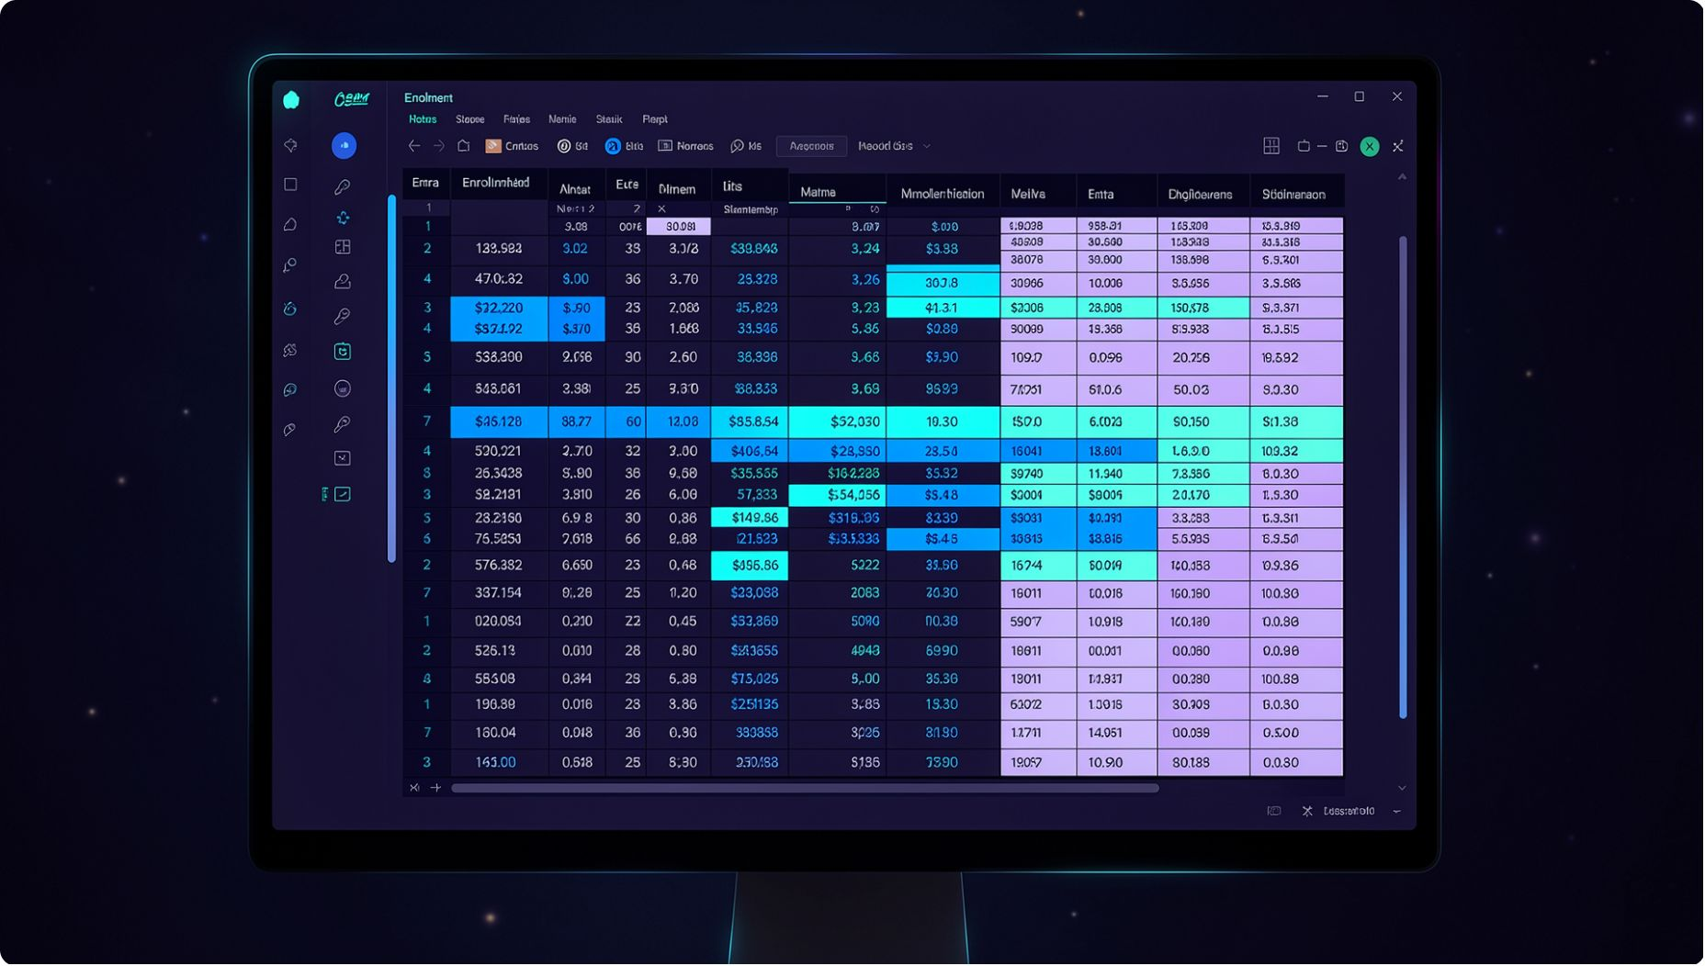
Current Pain Points
⏳ Inefficiency
Spreadsheet-based enrollment takes weeks to process, delaying course confirmations and academic planning for everyone involved.
🔍 Accessibility
Course information is scattered across multiple platforms, forcing students and faculty to waste time hunting for accurate data.
📈 Scalability
The current system breaks down during peak registration periods — precisely when reliability matters most.

Slide 4




AI-Suggested Solutions
Smart Course Recommendations
Automated Prerequisite Verification
Intelligent engine surfaces the right courses for each student based on academic history and degree progress.
Instant conflict detection prevents enrollment errors before they happen — no manual review required.
Predictive Enrollment Analytics
AI Chatbot Support
Forecasting tools help departments anticipate demand and allocate resources proactively each term.
24/7 instant answers to student FAQs reduce the administrative burden on faculty and staff.

Slide 5

Final Solution Selected
Real-time Enrollment
A Unified Web Portal Built for CS Departments
The selected solution brings every enrollment workflow into a single, intelligent platform:
Real-time enrollment management — live seat availability and instant confirmations
AI-powered recommendations — personalized course matching with prerequisite checks built in
Smart waitlist notifications — automated alerts the moment a seat opens
Faculty dashboard — course analytics and student tracking in one view
Faculty Analytics
AI Course Recommendations
Automated Waitlists

Slide 6
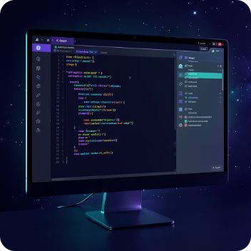
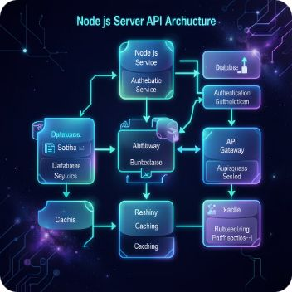

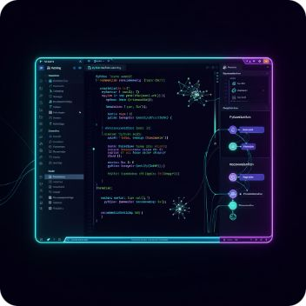
Technologies Used
Frontend
Backend
Database
AI / ML
React.js with fully responsive design for seamless access on any device.
Node.js & Express powering fast, scalable RESTful API services.
PostgreSQL for structured, secure, and reliable data management.
Python-based recommendation engine driving intelligent course suggestions.

Slide 7

Market Scope
50+
$2M+
CS Departments
Market Size
Nationwide target market for initial rollout
Estimated annual revenue potential
100%
Custom-Built
Department-specific customization — our key competitive advantage
Beyond CS departments, the platform is architected for expansion across all STEM departments, multiplying the addressable market significantly.

Slide 8



Key Benefits
For Faculty
80% reduction in administrative time — freeing hours every semester for research, mentorship, and teaching.
For Students
Faster, more accurate enrollment with AI-matched course suggestions that align with individual academic goals.
For the Department
Improved data insights and smarter resource planning — enabling leadership to make confident, data-driven decisions.

Slide 9
Implementation Timeline
Phase 1 — Months 1–2
1
Core enrollment system launch: portal foundation, real-time seat management, and user authentication.
2
Phase 2 — Months 3–4
AI recommendation engine integration: prerequisite checking, conflict detection, and smart waitlist automation.
Phase 3 — Months 5–6
3
Analytics dashboard and optimization: faculty insights, enrollment forecasting, and performance tuning.

Slide 10

Next Steps
1
Secure Approval & Budget
Obtain departmental sign-off and confirm budget allocation to move the project into active development.
2
Build the Team & Set the Timeline
Assemble the development team, assign roles, and lock in sprint milestones aligned to the three-phase roadmap.
3
Launch Pilot Testing
Begin a controlled rollout with select courses to validate functionality and surface early issues.
4
Iterate Based on Feedback
Collect structured input from faculty and students to drive continuous improvement before full deployment.

